Slide 1

Product Release November 14th,2018

Slide 2
Wednesday 14th (09:30 – 01:30)
Agenda
1. New Product Release (Keith)
2. Color definitions P1/P2 program (Megan)
3. Room defaults (Tina)
4. Finish Cabinet Bottoms (Tina)
5. Available Accessories or Modifications (Dieter)
5. Apron Sinks (Tina)
6. CC-Raise bottoms (Tina)
7. LOOX Lighting System (Scott)
8. Flush-mount Cabinets (Scott)
9. HFU`s and Custom Library (Dieter)
Thank you all for being here!

Slide 3
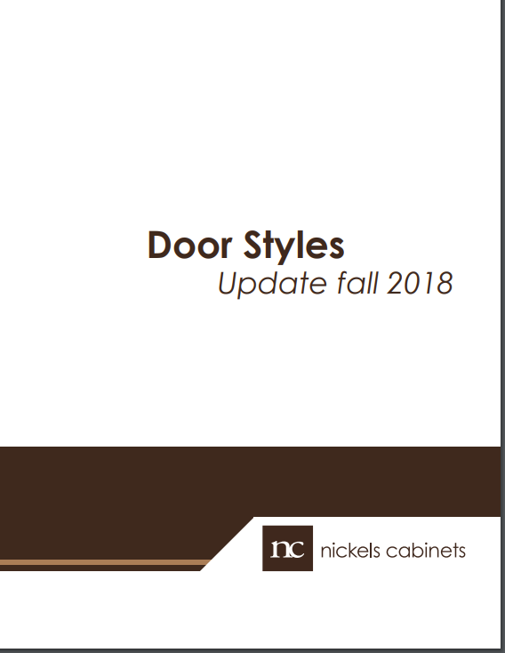
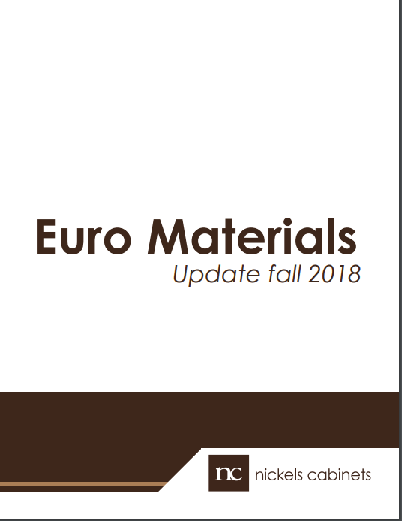
By Keith

Slide 4
Color Definitions P1 / P2
By Megan

Slide 5
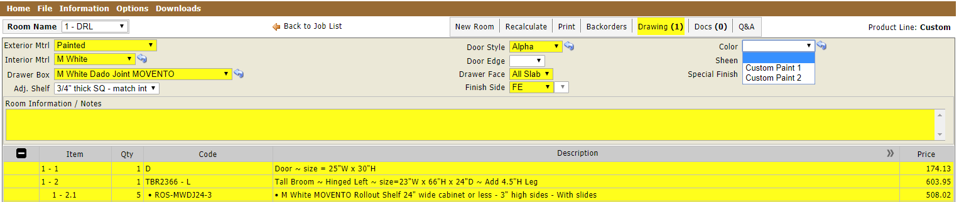
By Megan

Slide 6
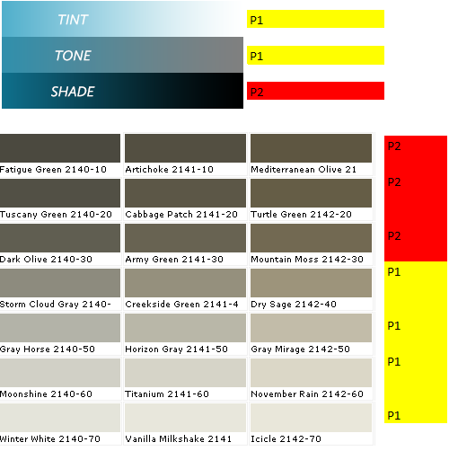
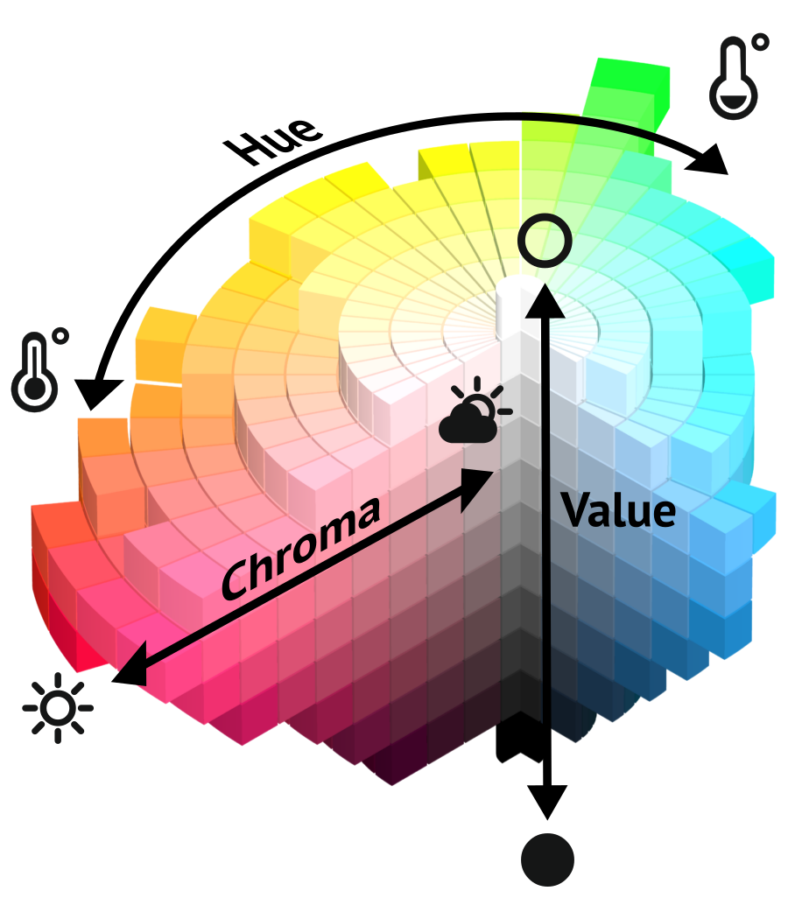
Color Definitions P1 / P2
CUSTOM CODE | PAINT NAME | PAINT - MANUFACTURE | P1 | P2
P10278 | 2108-50 Silver Fox | BM | X
P10276 | Smokey Taupe 983 | BM | X
P10274 | Early Morning CC-818 | BM | X
P10273 | 2141-60 Titanium | BM | X
P10271 | CSP-95 SEA SALT | BM | X
P10267 | Halcyon Green SW 6213 | SW | X
P10264 | 2146-30 Split Pea | BM |  | X
P10263 | Joie de Vivre MQ4-6 | BEHR |  | X
P10258 | HC-115 = Georgian Green | BM | X
P10253 | Hague Blue No. 30 | Farrow & Ball |  | X
P10252 | Aleutian SW 6241 | Sherwin Williams | X
P10250 | Fiddlehead Green | BM |  | X
P10249 | True Green 2042-10 | BM |  | X
P10247 | Pavilion Gray No. 242 | Farrow & Ball | X
HUE (COLOR) AND SHADES ARE P2
WHEN THE CHROMA IS HIGHER IN THE HUE IT WILL BECOME
BRIGHTER WHICH MAKES IT A P2.
*REMBER IF THE COLOR IS DARK OR BRIGHT IT'S A P 2
By Megan

Slide 7
Room Defaults
Finished Cabinet Bottoms
CC – Raise Bottoms
Cabinet Base Apron Sink (BAS)
By Tina

Slide 8
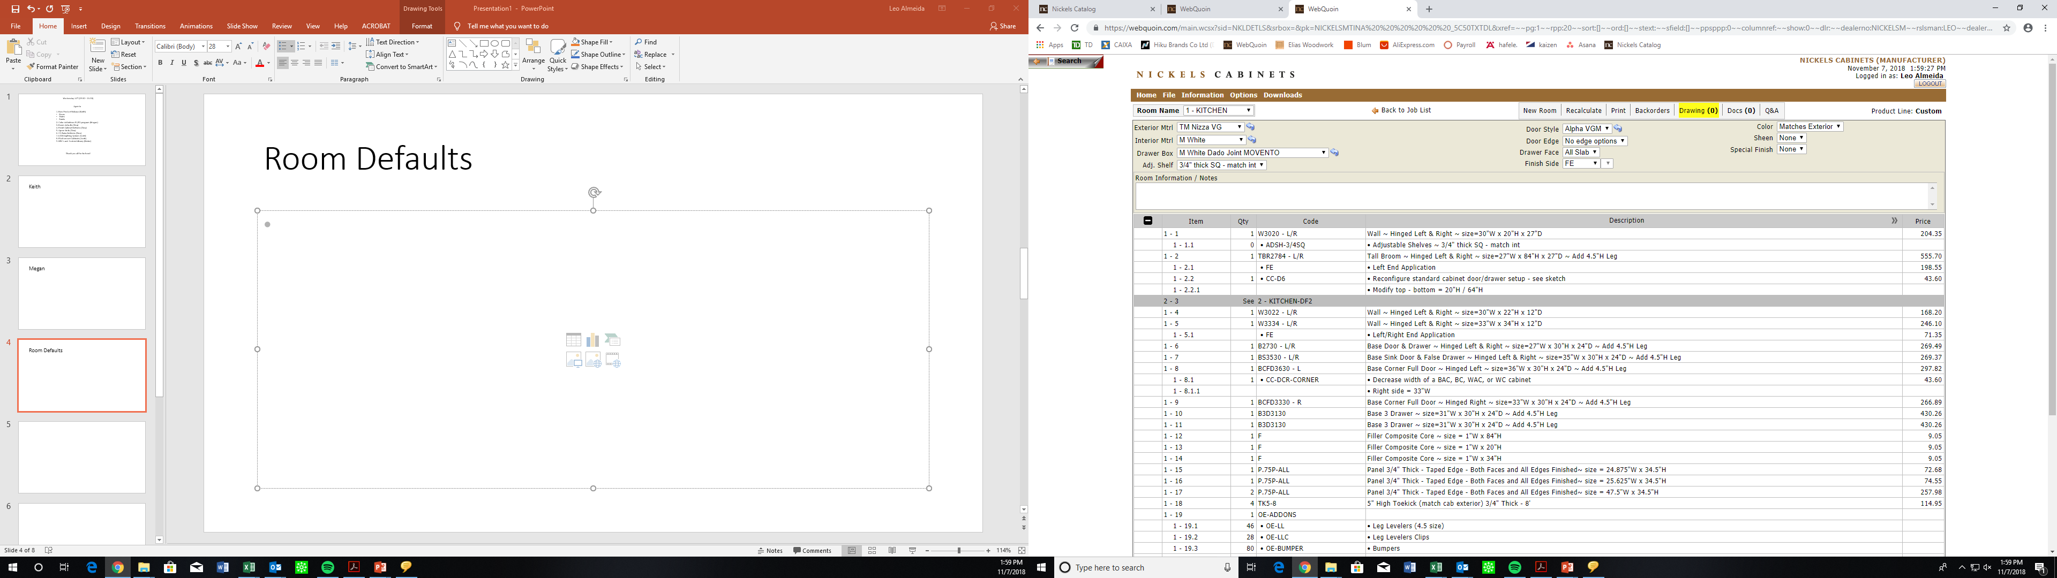
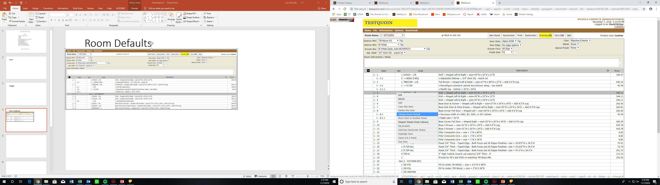
Room Defaults (Current state)
We will no longer have this option available in WebQuoin
By Tina

Slide 9
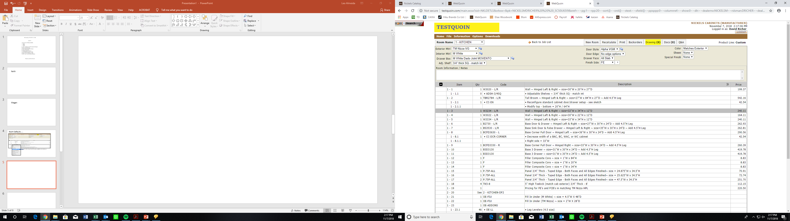
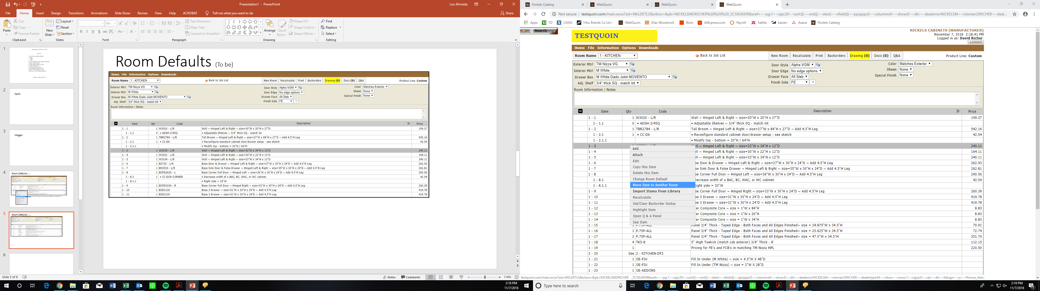
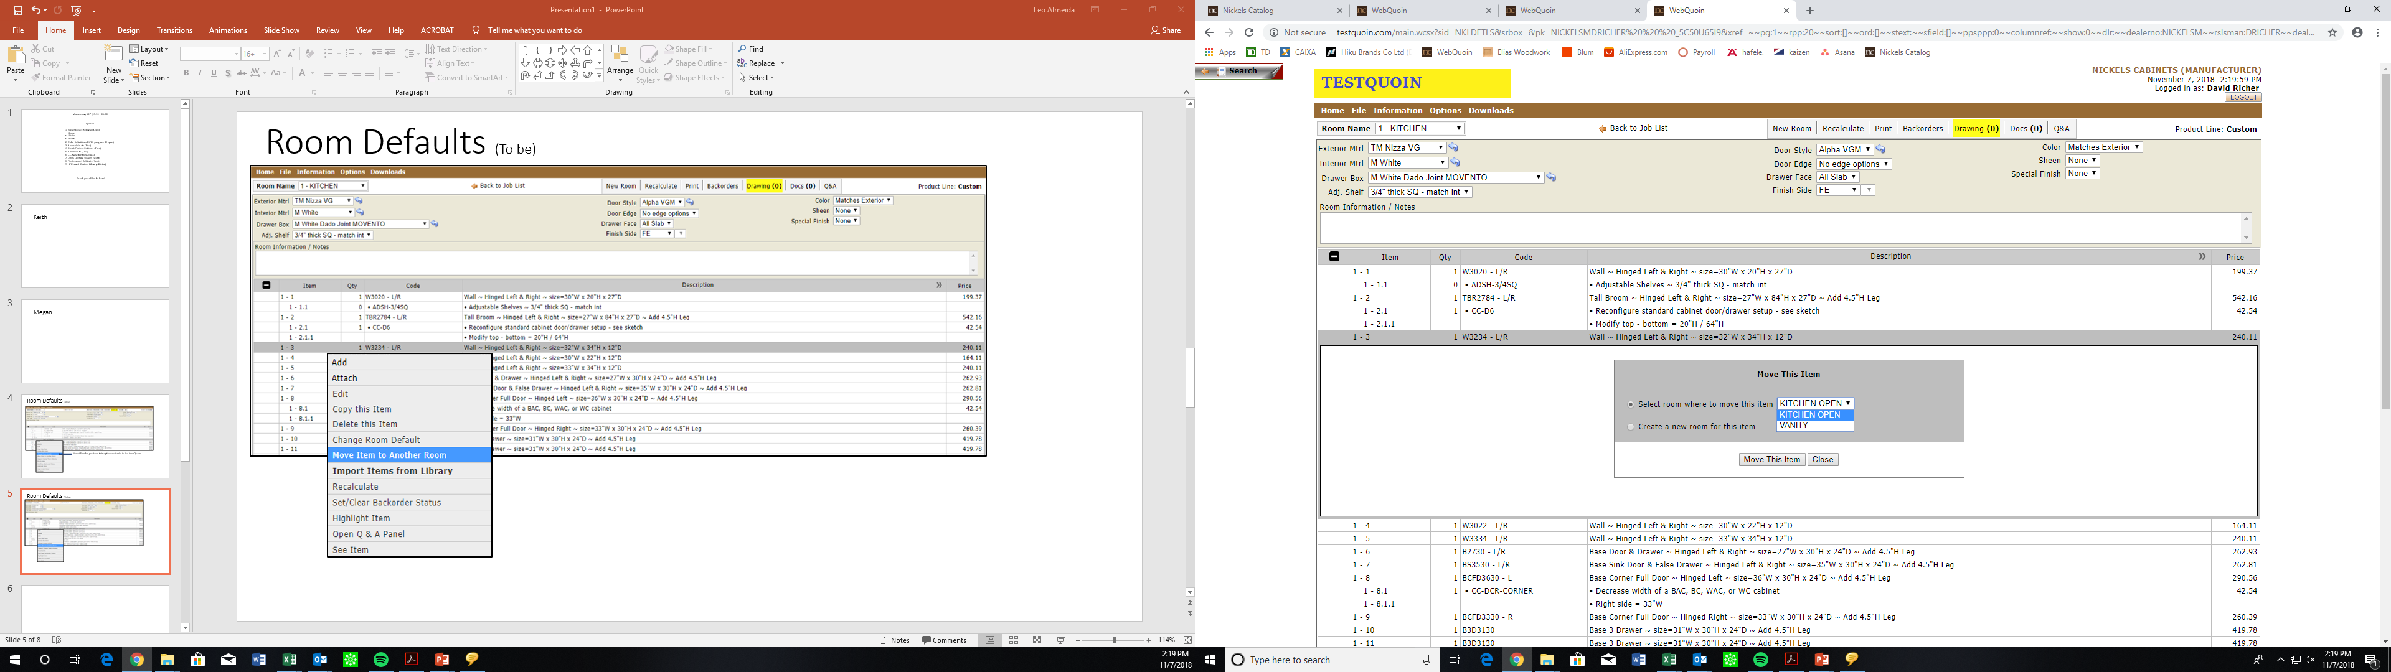
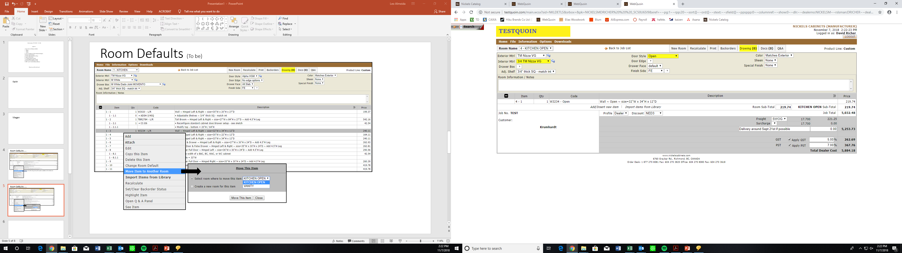
Room Defaults (Update)
Note:
After update you will not be able to move items out of default rooms. Please call or e-mail the order desk.

Slide 10
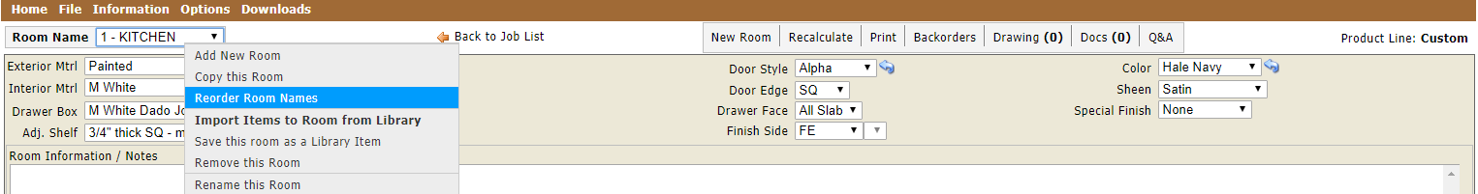
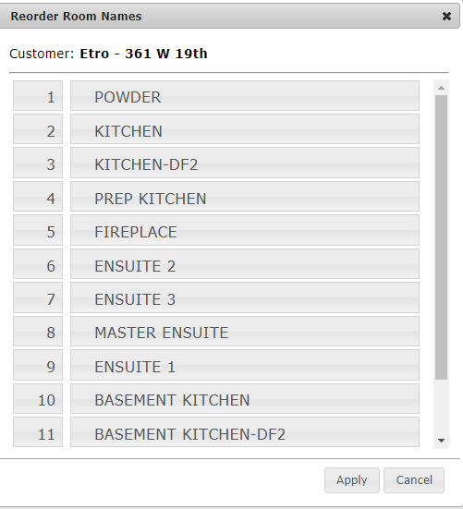
How to re-organize rooms
By Tina

Slide 11
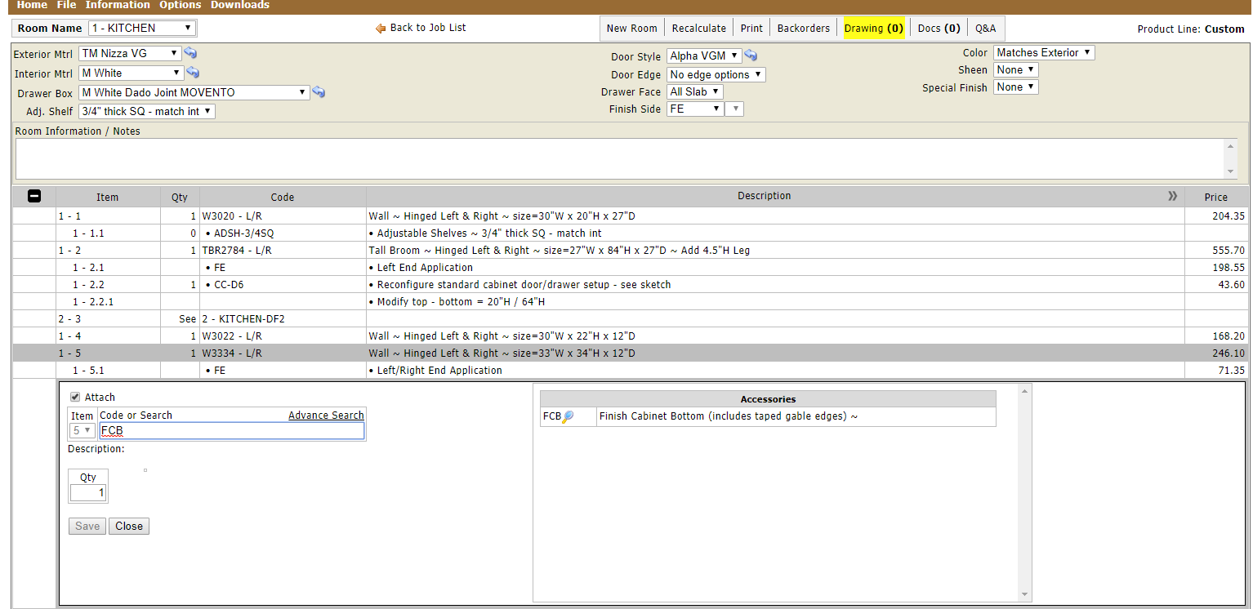
Cabinet Bottom will always match the interior material unless you attach a Finish Cabinet Bottom (FCB)
Finish Cabinet Bottoms (Current state)
By Tina

Slide 12
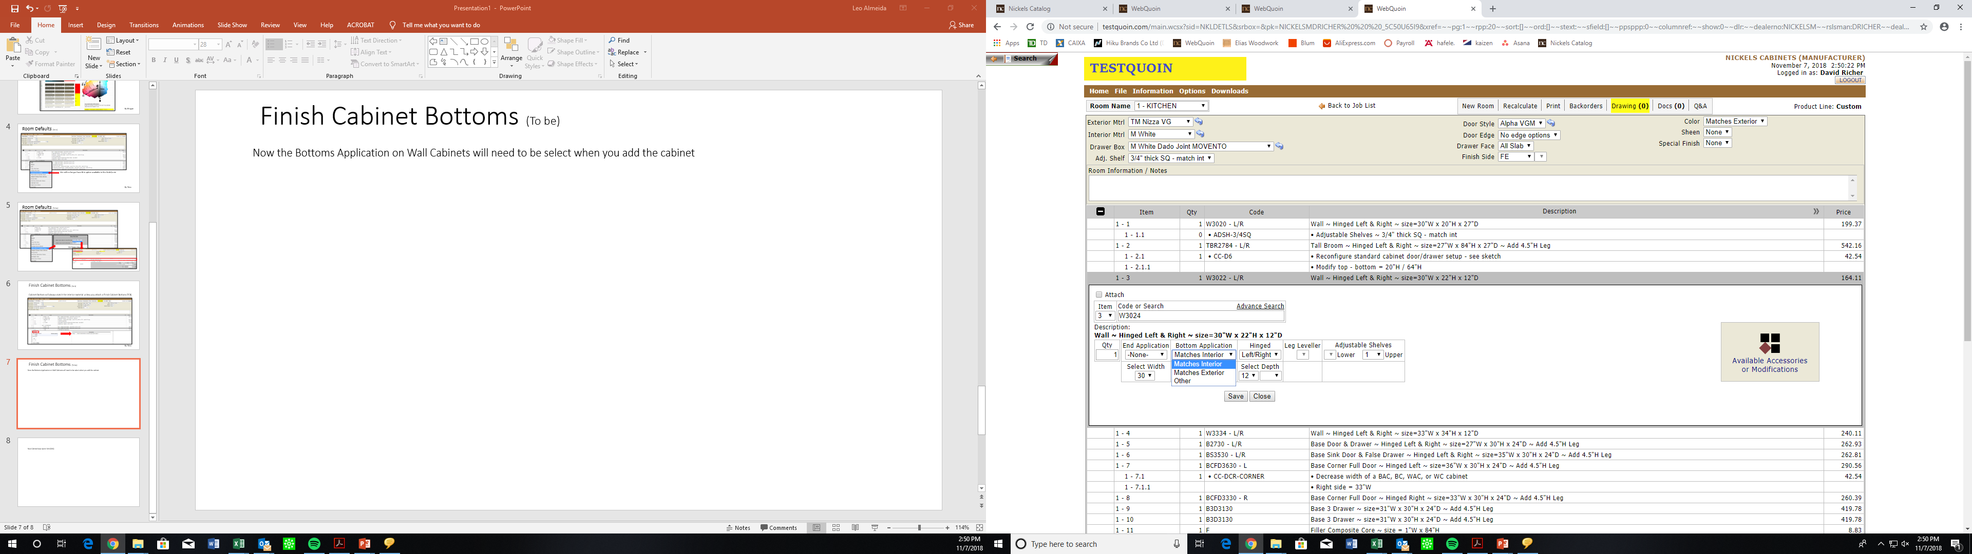
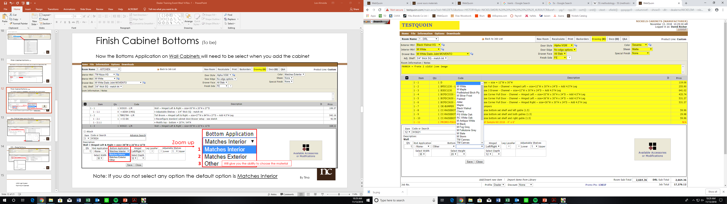
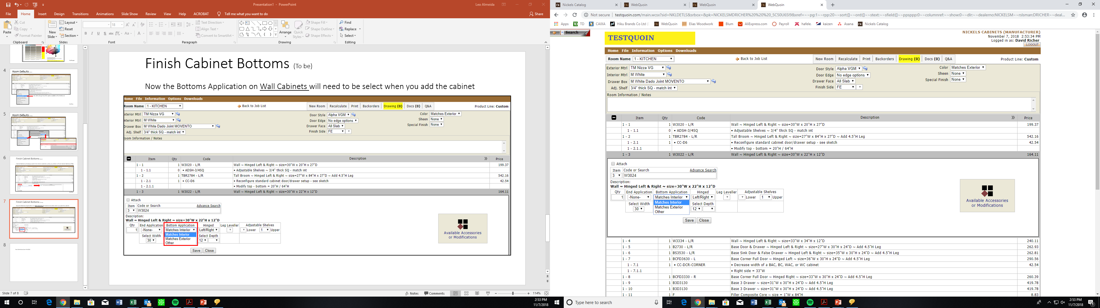
Now the Bottom Application on Wall Cabinets will need to be selected when you add the cabinet
Finish Cabinet Bottoms (Update)
Zoom up
1
2
3
Will give you the ability to choose the material
Notes:
If you do not select an option, the default is Matches Interior
FCB-Finish Cabinet Bottom and FCT-Finish Cabinet Top will still be available for situations where you want to finish bottoms of base or vanity cabinets, or tops of cabinets
By Tina

Slide 13
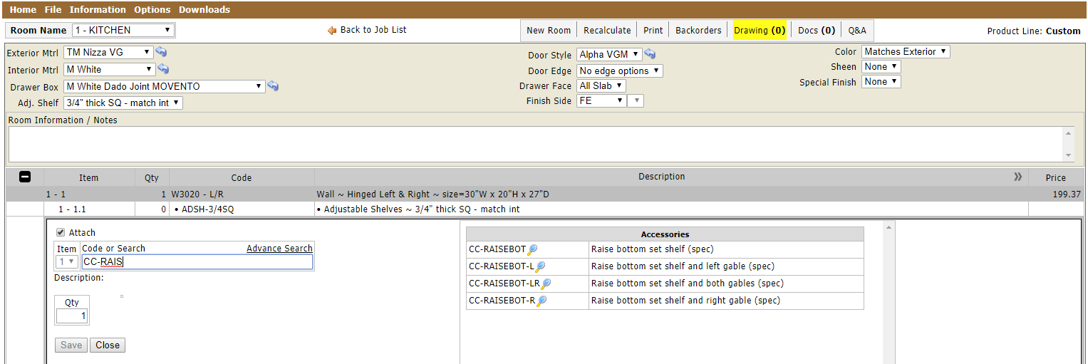
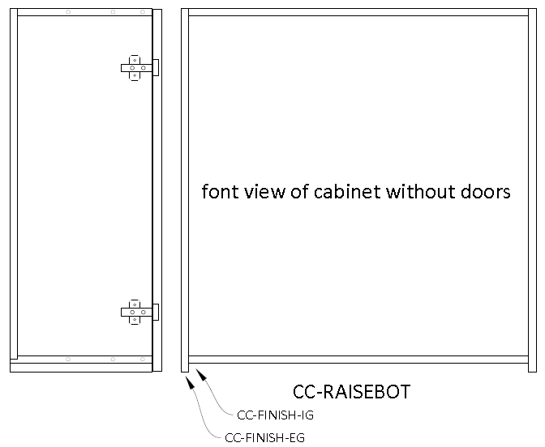
CC – Raise Bottoms
New codes
CC-FINISH-IG Finish Inside Gable
CC-FINISH-EG Finish Extended Gable Edge
Front view of cabinet without doors
By Tina
By Tina

Slide 14
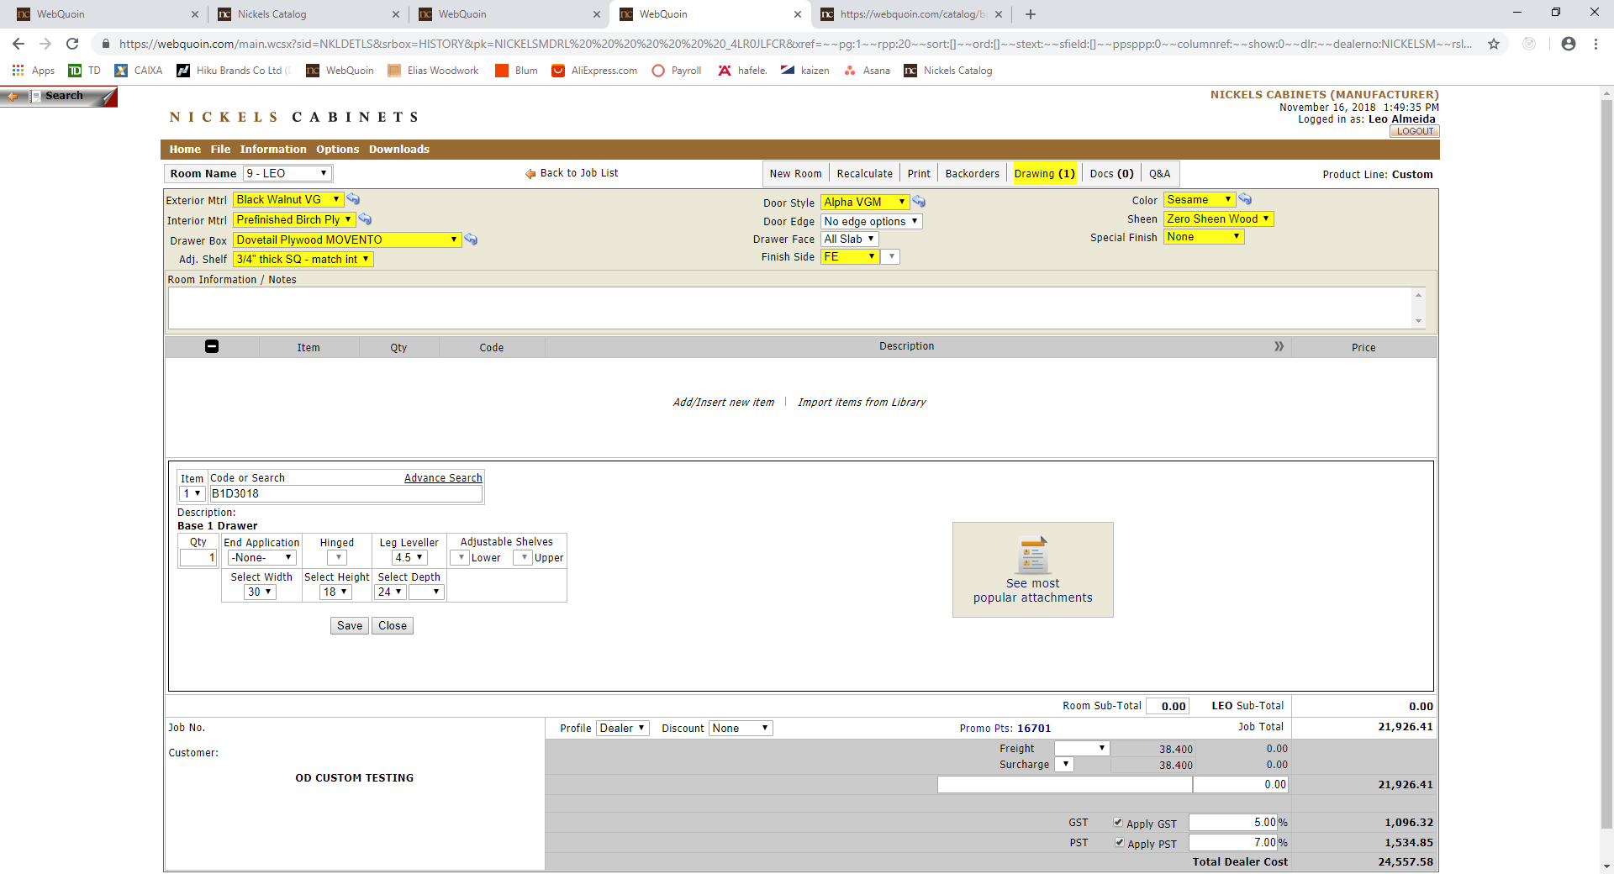
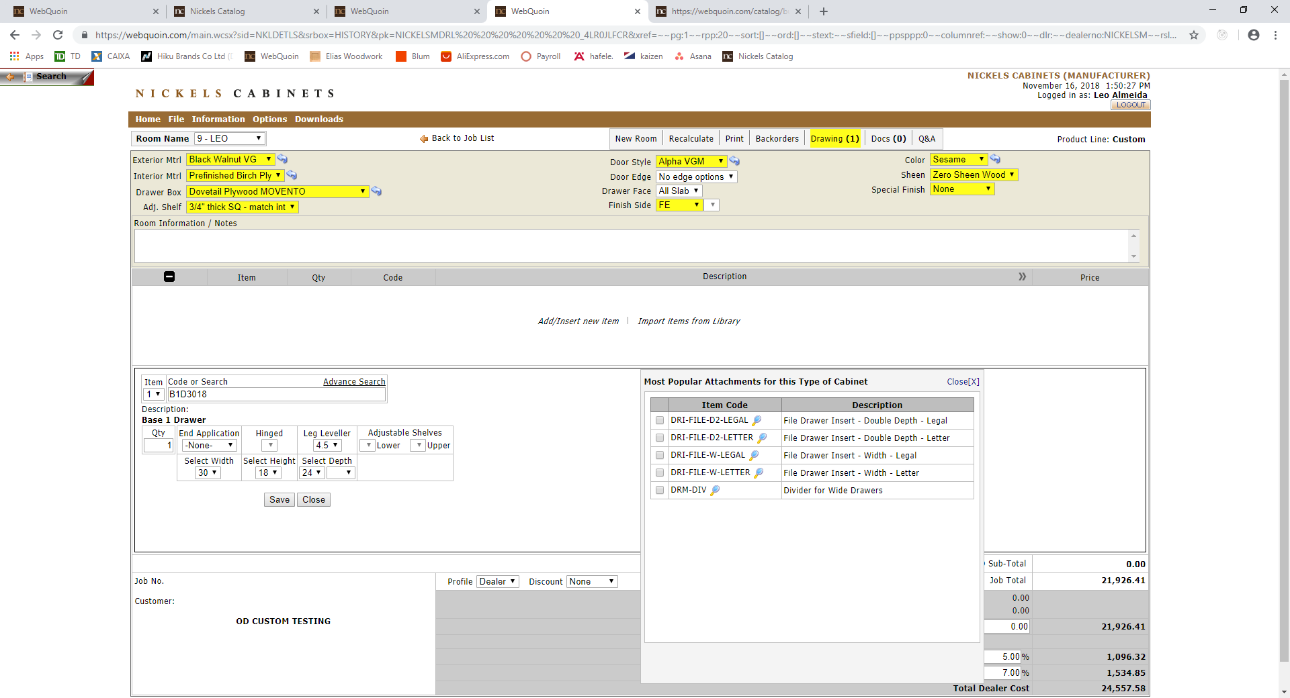
Most Popular Attachments (Current state)
Note:
When you click on the Icon you will get a list of accessories most commonly used for that cabinet specifically
by group size.
By Dieter

Slide 15
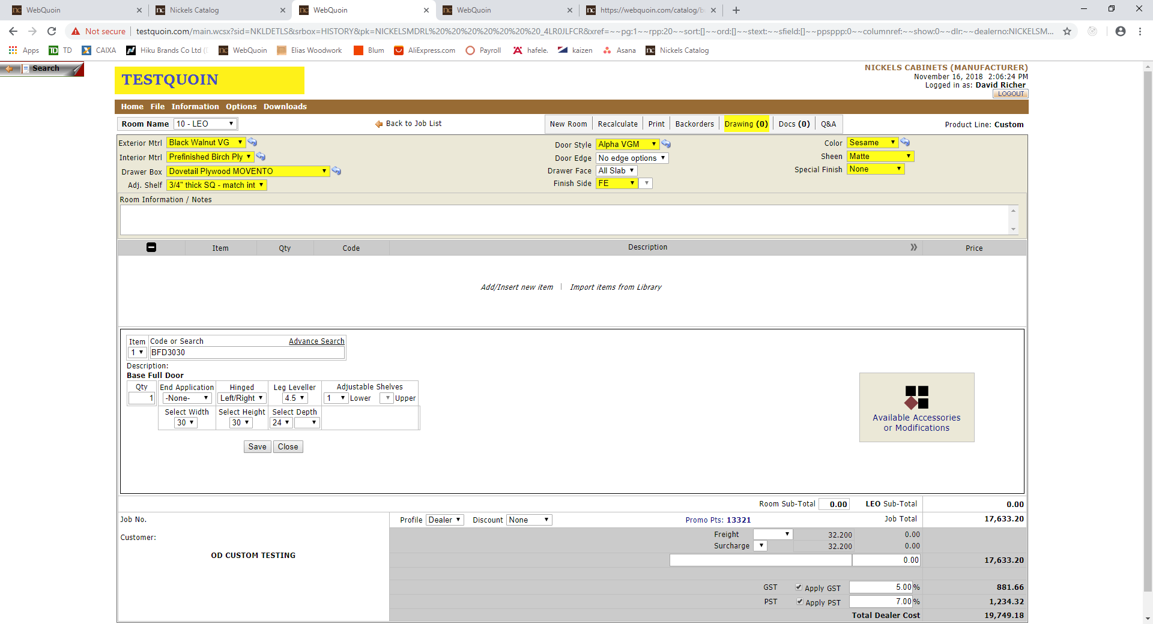
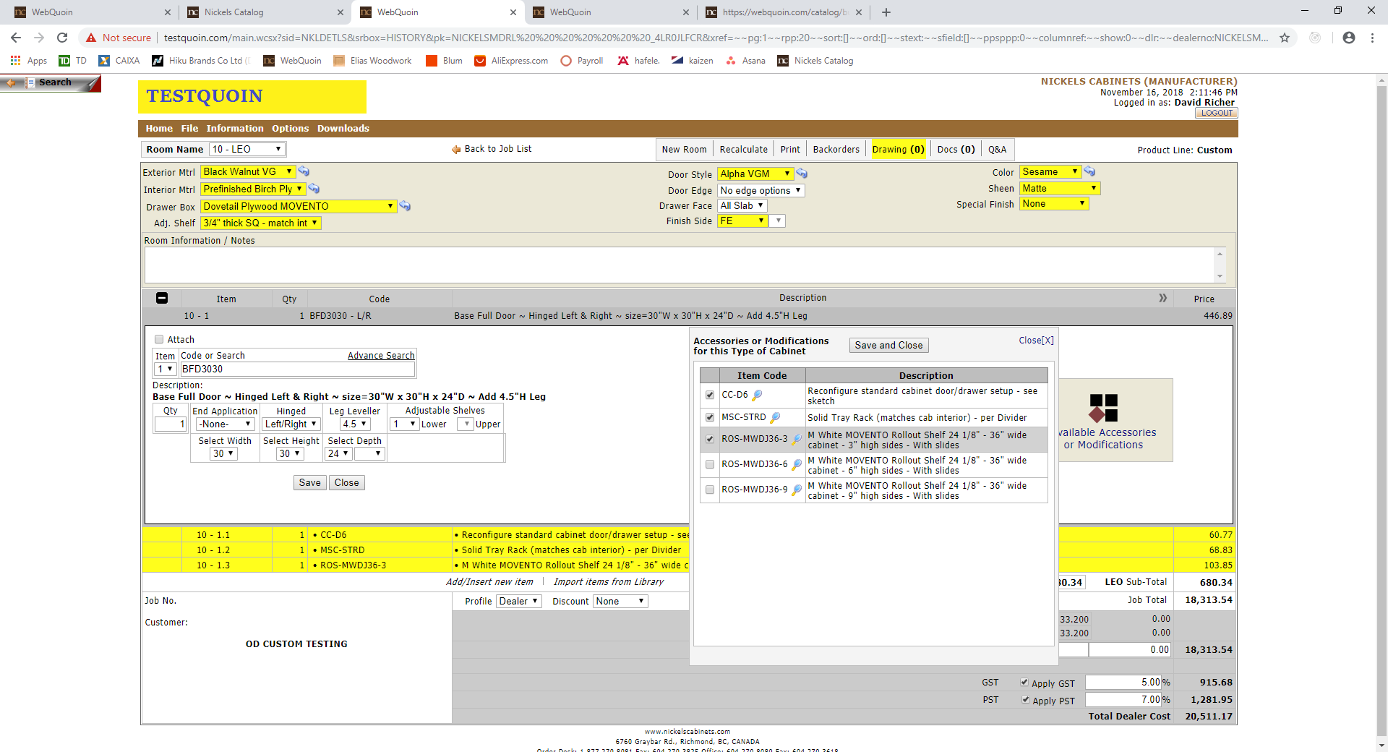
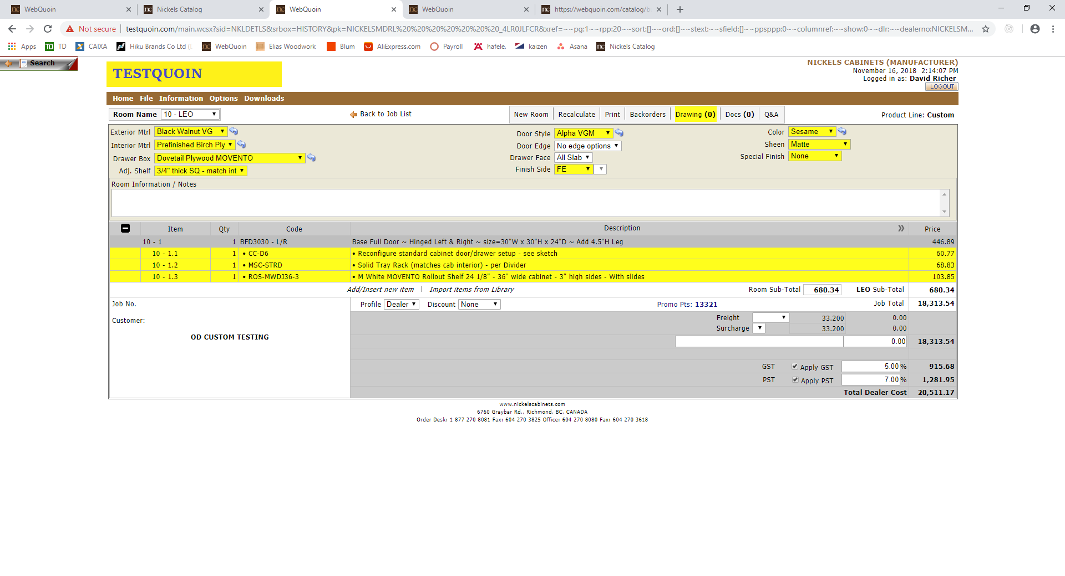
Available Accessories or Modifications (Update)
Note:
When you click on the Icon you will get a list of accessories most commonly used for that specific cabinet type and width.
You can choose one or multiple accessories and save to that cabinet.
By Dieter

Slide 16
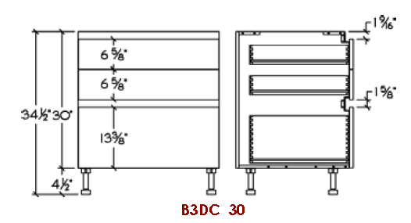
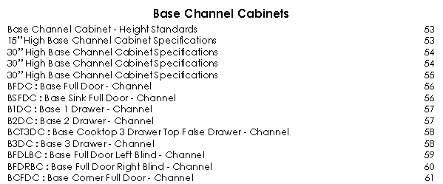
Base Channel Cabinets
By Tina

Slide 17
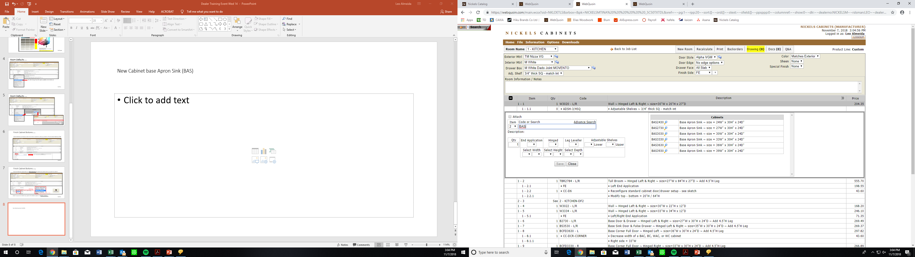
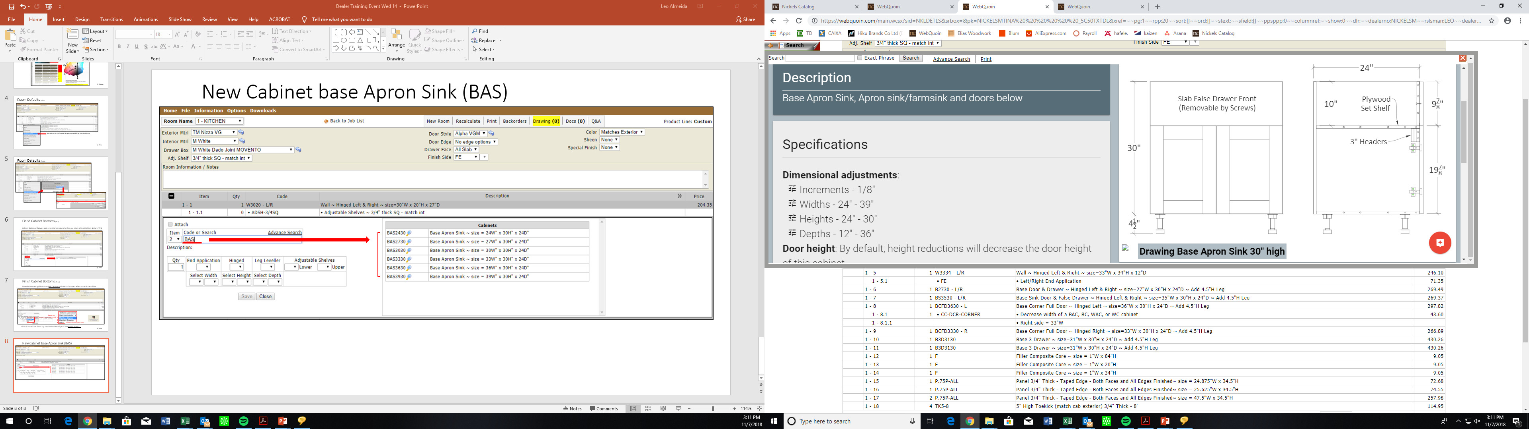
New Cabinet Base Apron Sink (BAS)
By Tina

Slide 18
Hafele - LOOX Light System
Flush-mount Cabinets
By Scott

Slide 19
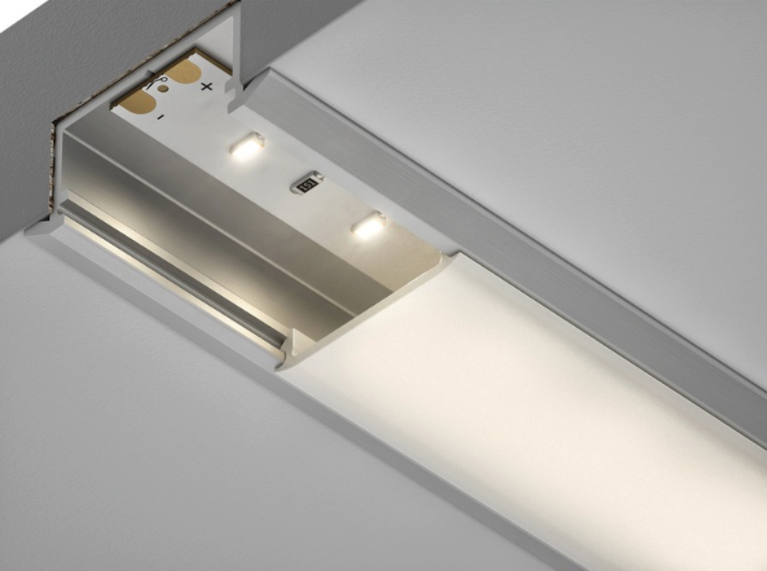
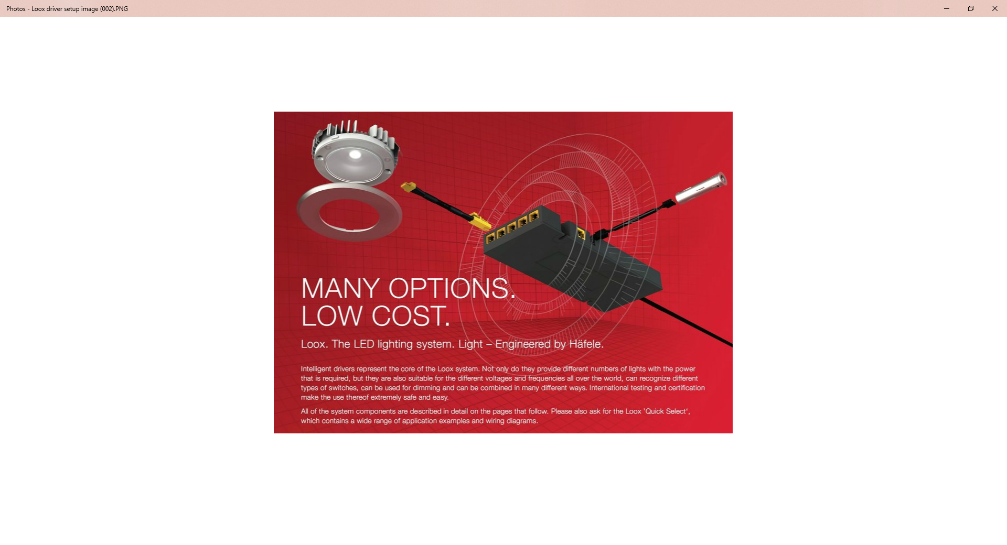
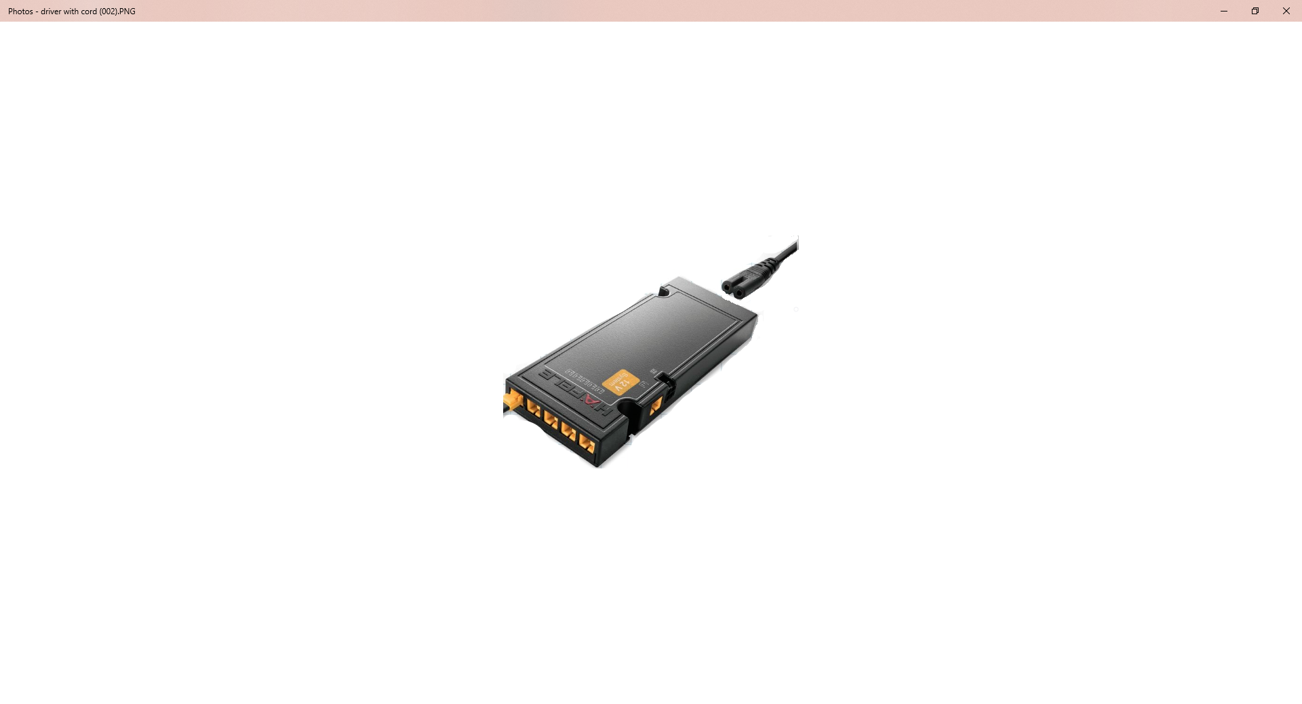
Hafele - LOOX Light System
By Scott

Slide 20
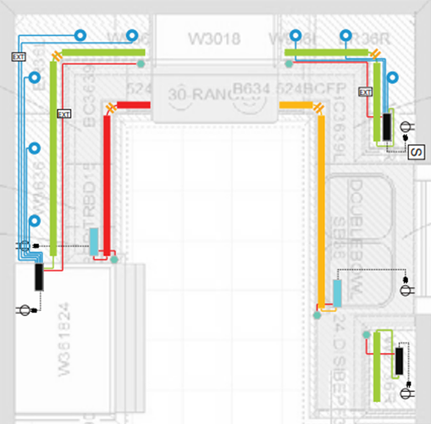
Electrical design and layout:
Dealer needs to answer questions of how their LED lights will be wired with their electrician.
Where will the drivers be installed?
Will the driver be hard wired or plugged into an outlet?
Will the low voltage wiring be pulled behind the walls by the electrician? (use LED-PWR-40W-DIM) dimmable by approved wall switch. (see driver specs)
Will the wiring be outside the walls and plugged into a driver that is plugged into a wall electrical outlet? (use LED-KIT-PWR-40W) only dimmable with LOOX switch. ON/OFF with standard wall switch.
By Scott

Slide 21
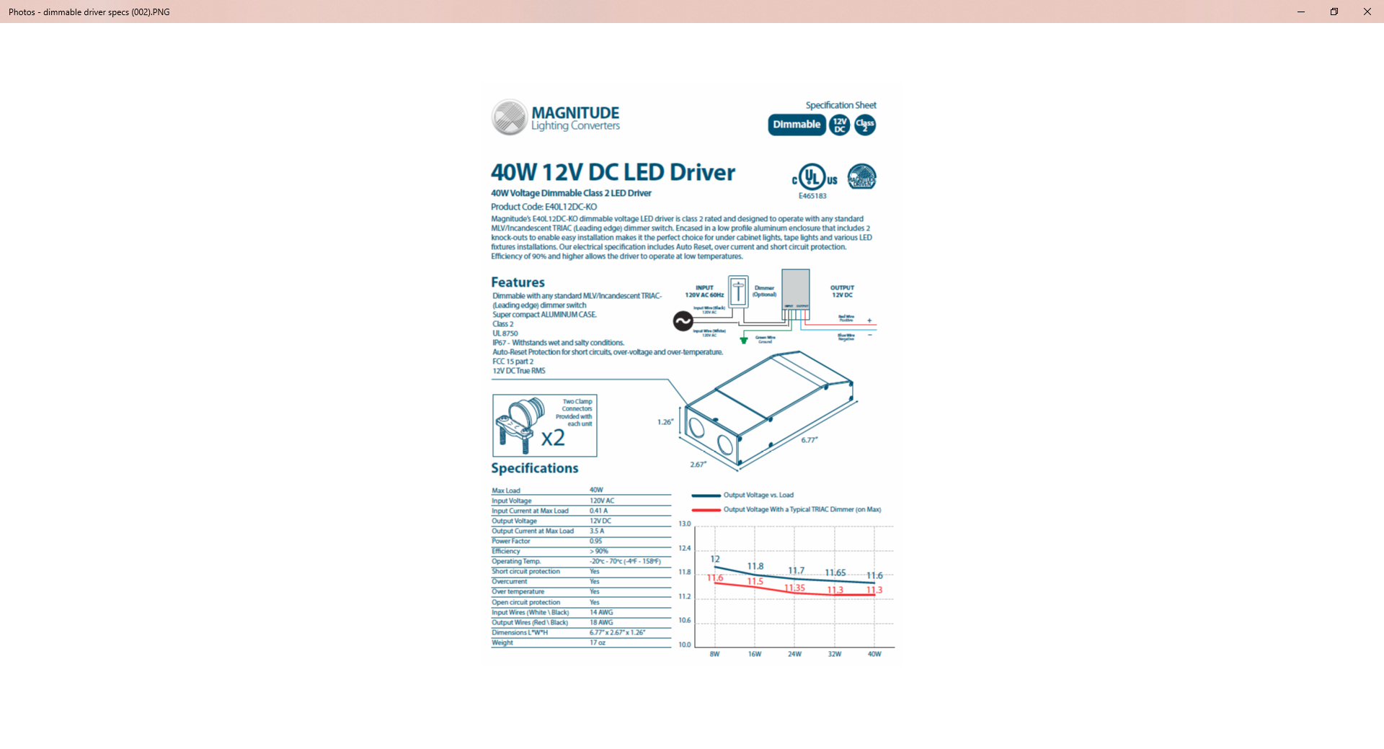
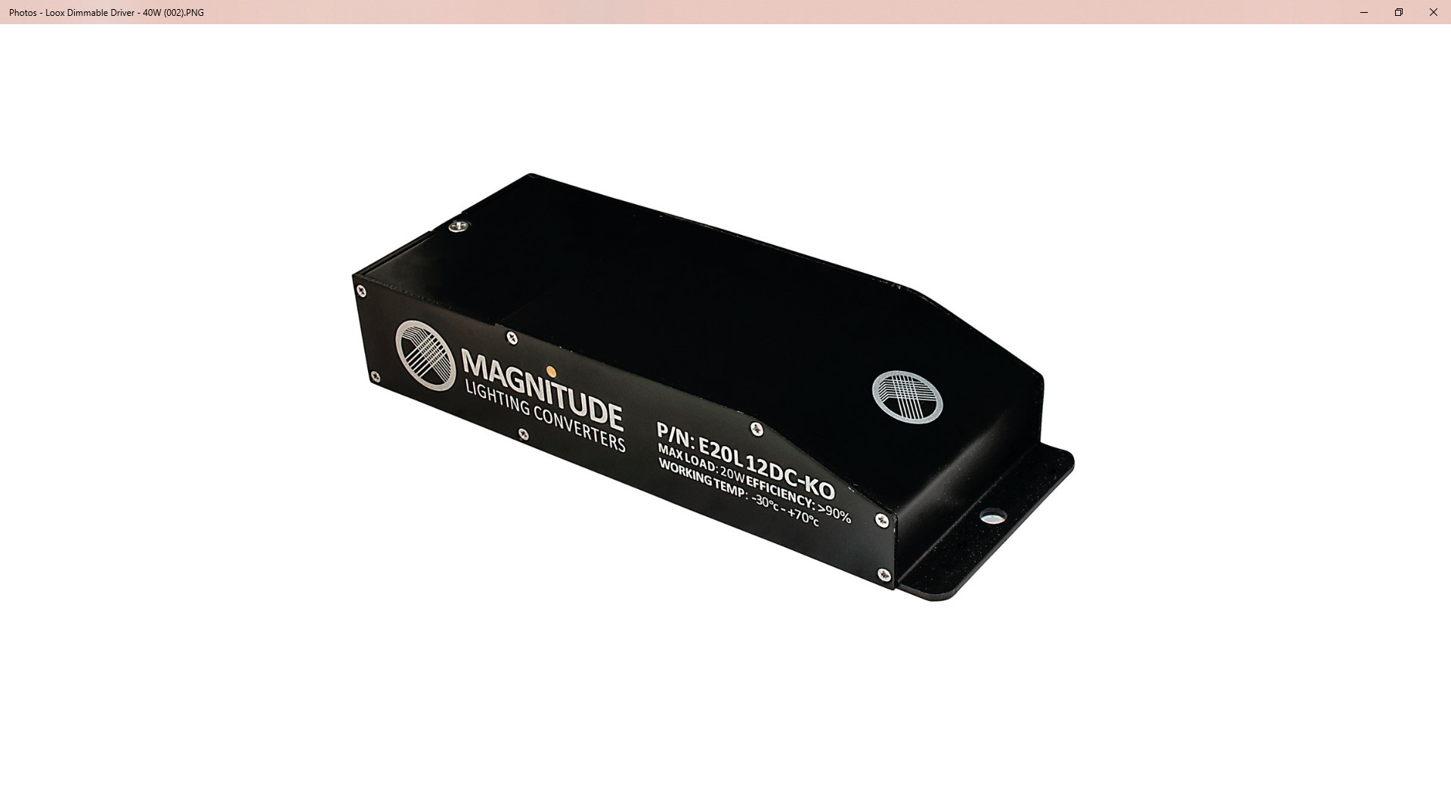
Will the low voltage wiring be pulled behind the walls by the electrician? (use LED-PWR-40W-DIM) dimmable by approved wall switch. (see driver specs) Hardwired by electrician.
LED-PWR-40W-DIM
By Scott

Slide 22
LED-KIT-PWR-40W
Wiring will be outside the walls and plugged into a driver that is plugged into a wall electrical outlet (use LED-KIT-PWR-40W) only dimmable with LOOX switch. ON/OFF with standard wall switch.
By Scott

Slide 23
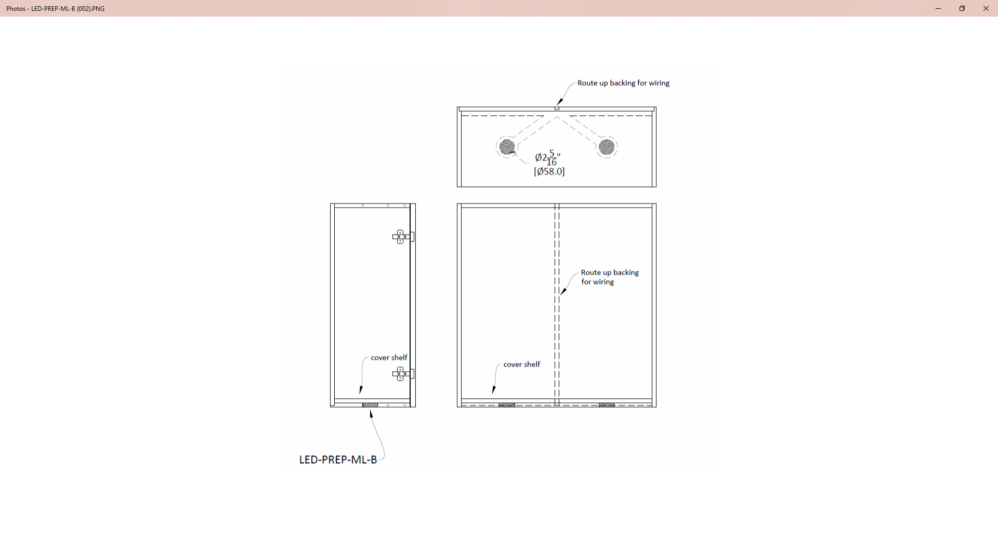
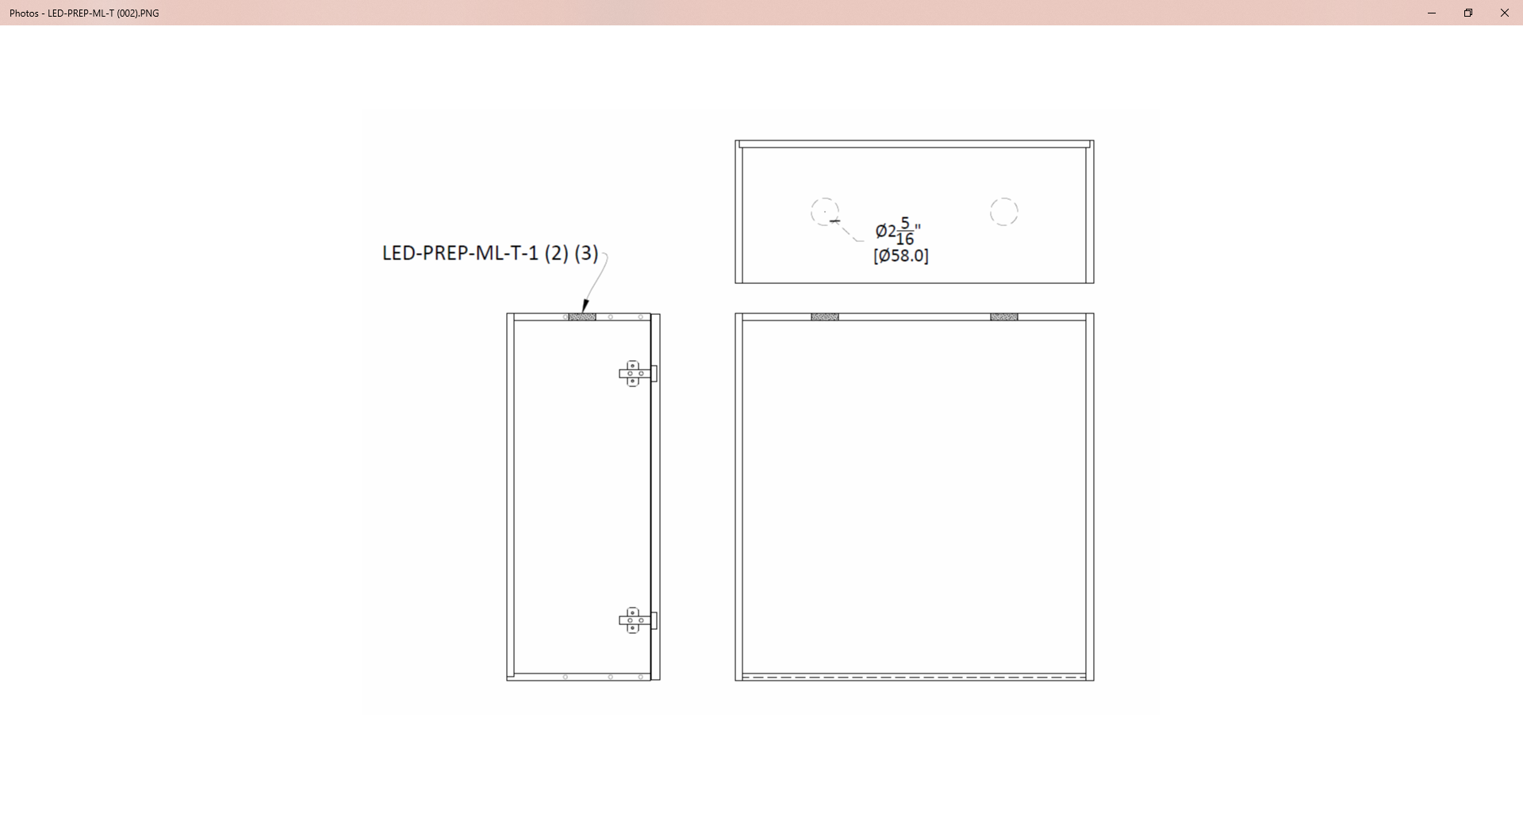
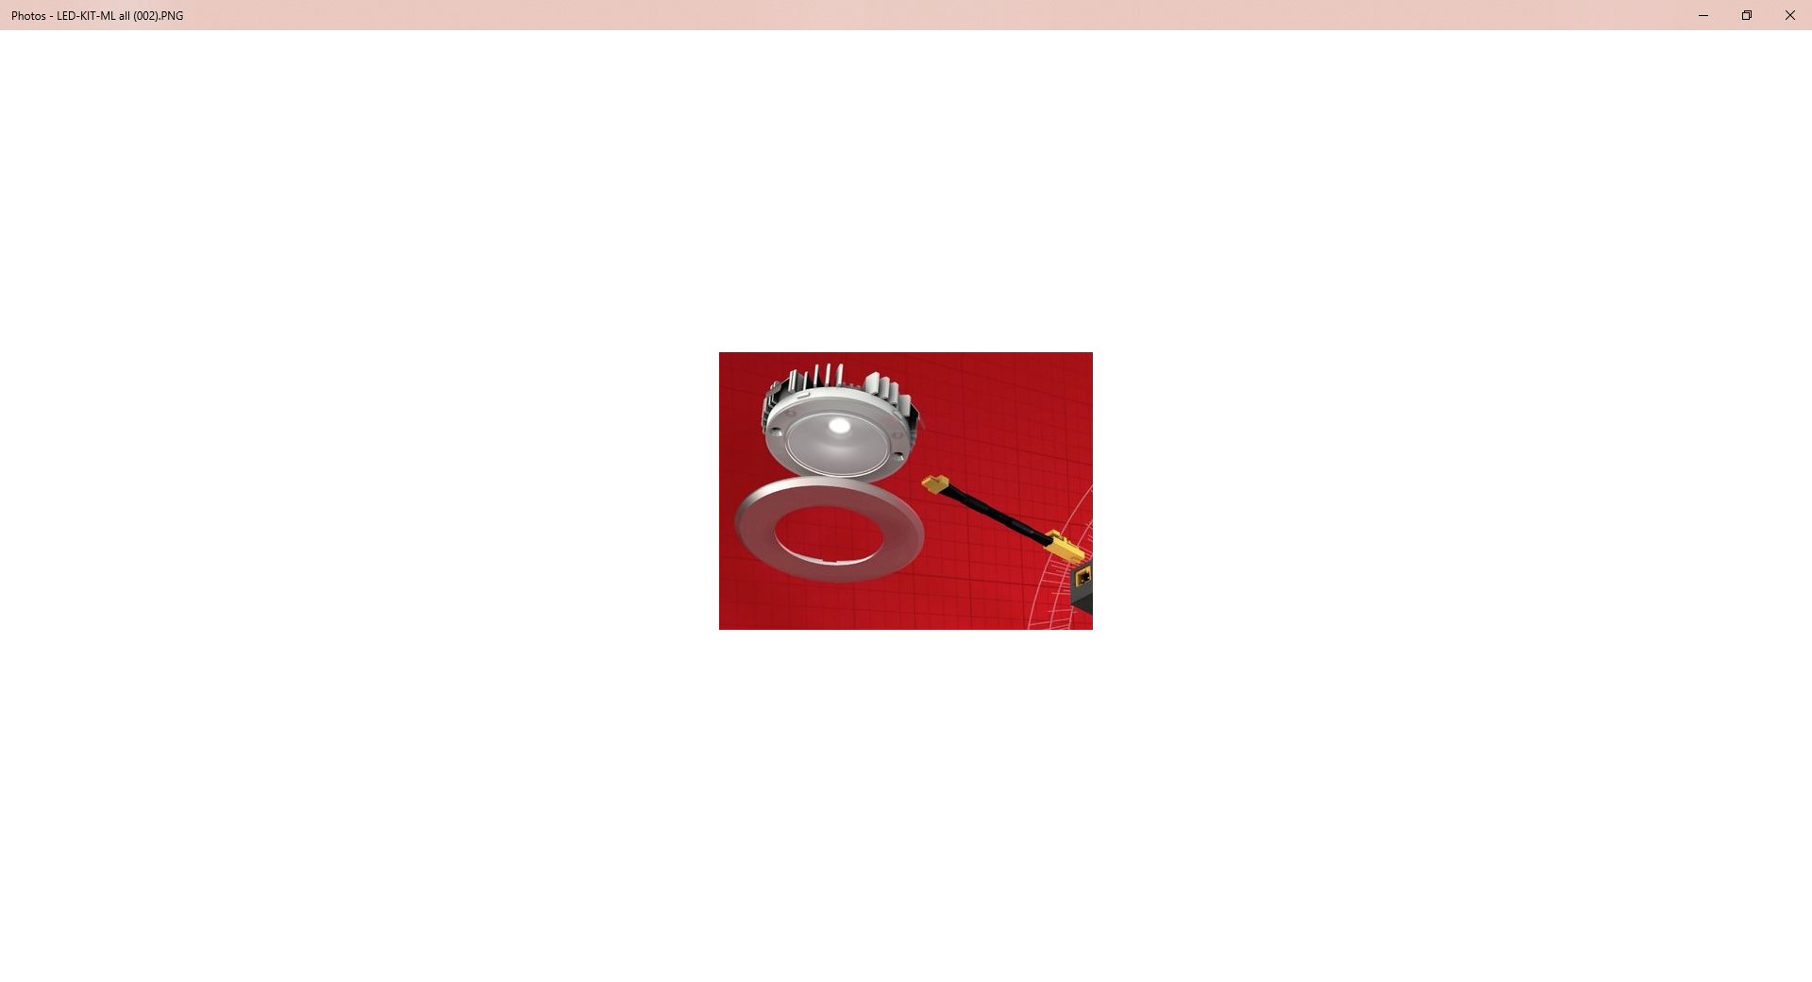
Prep cabinets for LOOX Modular puck lights
Use LED-PREP-ML-(T) (B) code
By Scott

Slide 24
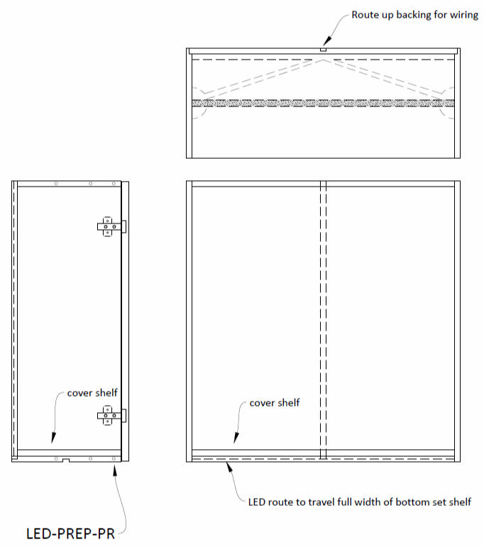
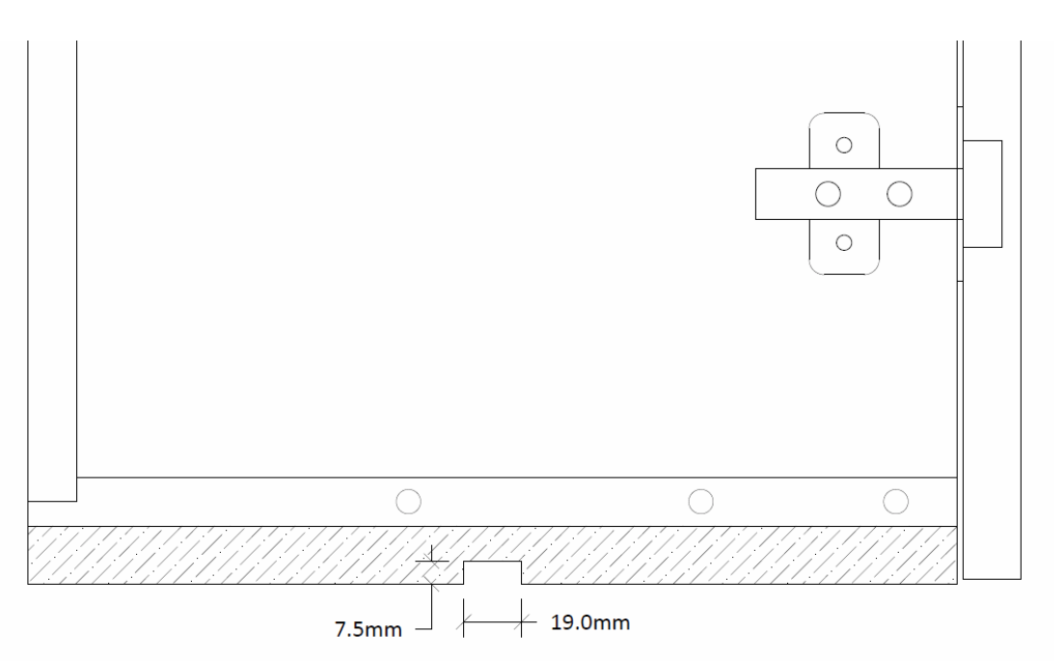
Preparation of cabinets for LOOX lighting (aluminum profile) LED-PREP-PR
By Scott

Slide 25
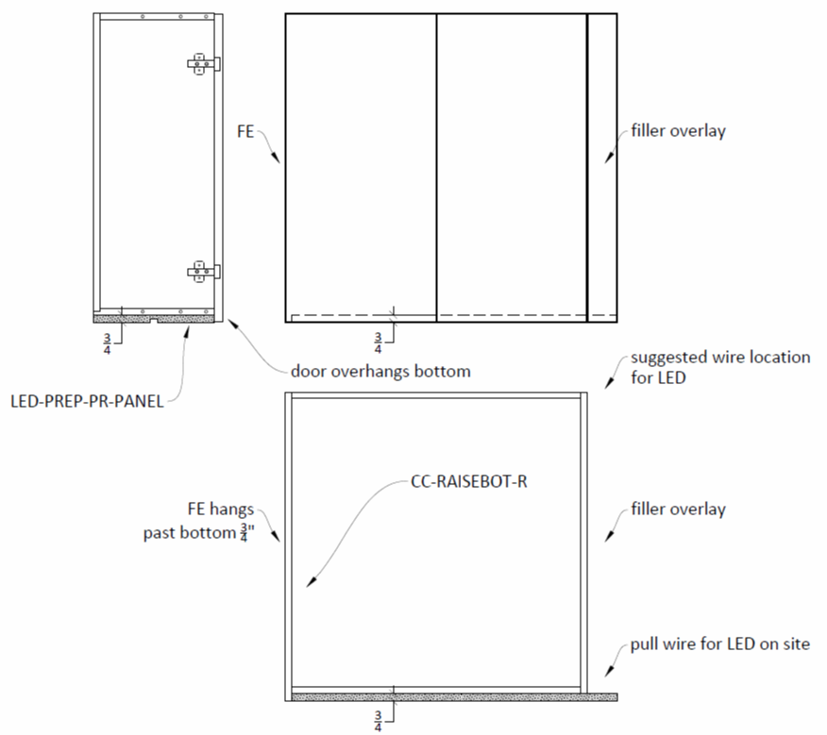
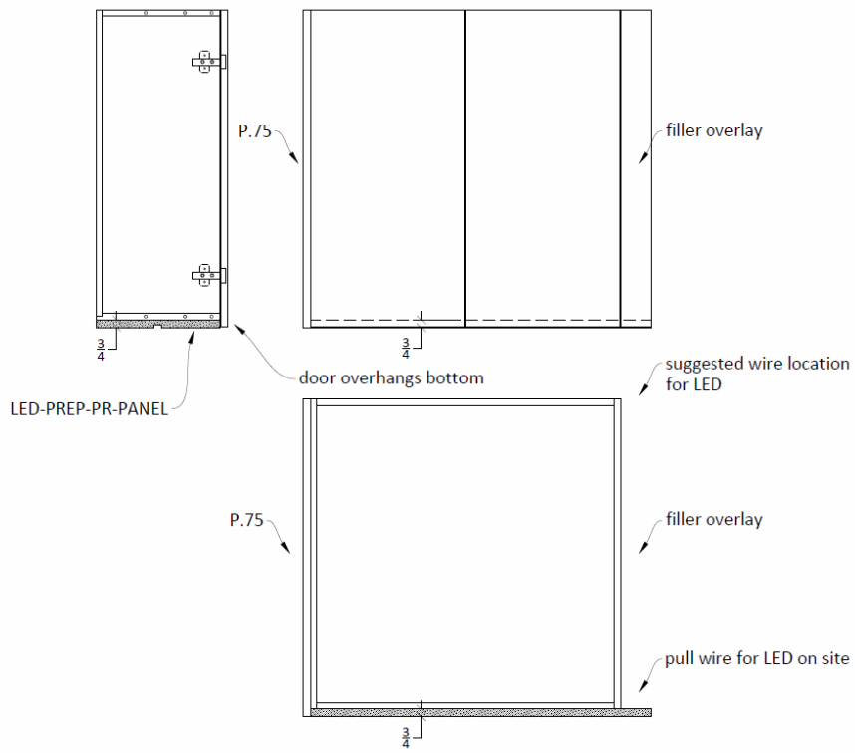
Preparation of cabinets for LOOX lighting (aluminum profile) LED-PREP-PR-PANEL
By Scott

Slide 26
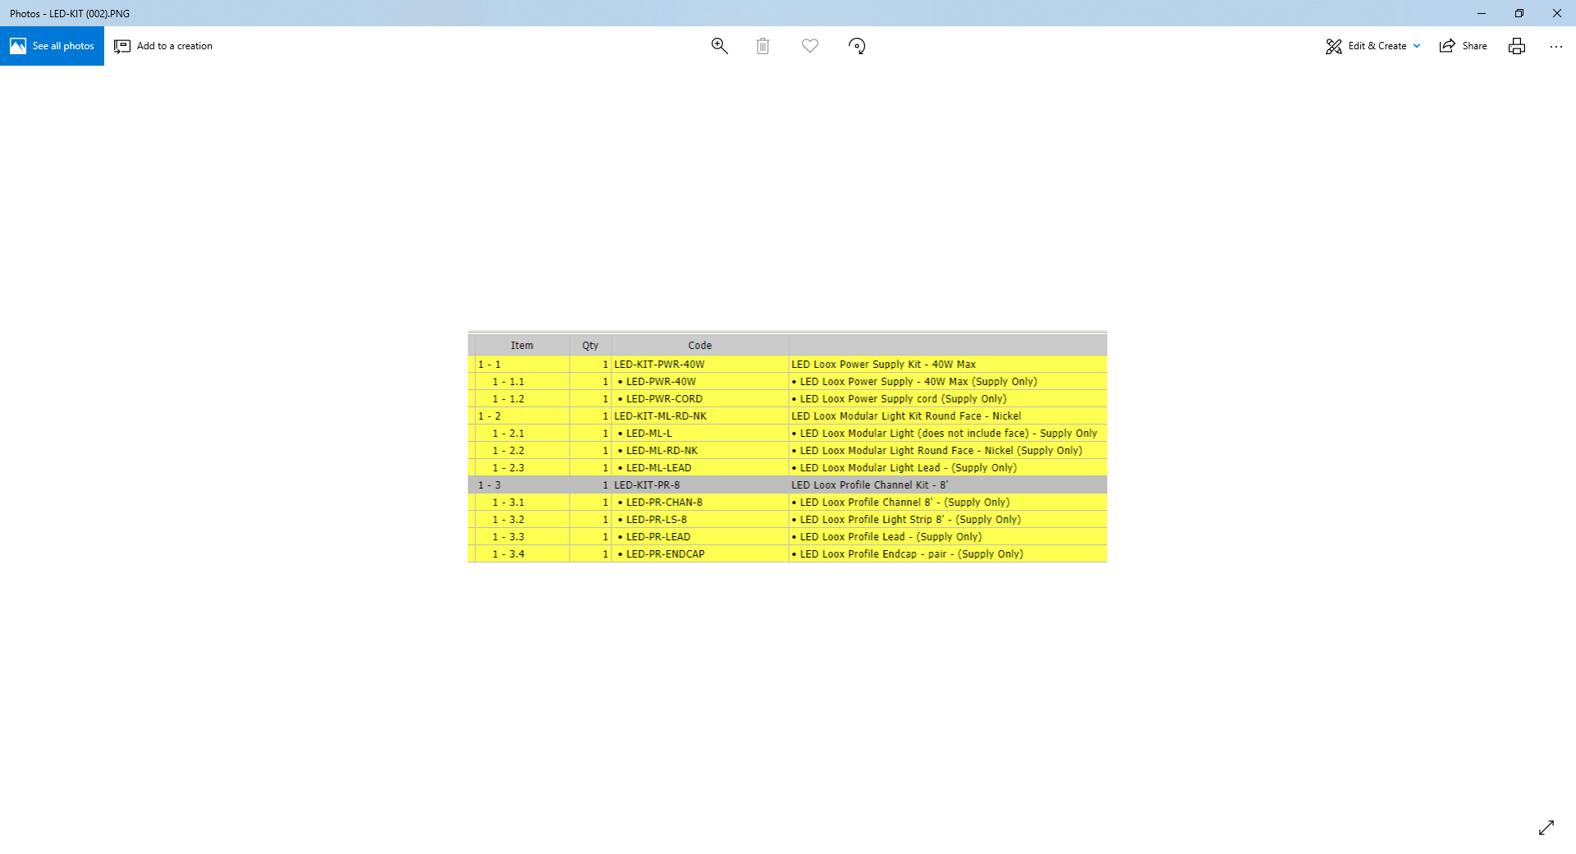
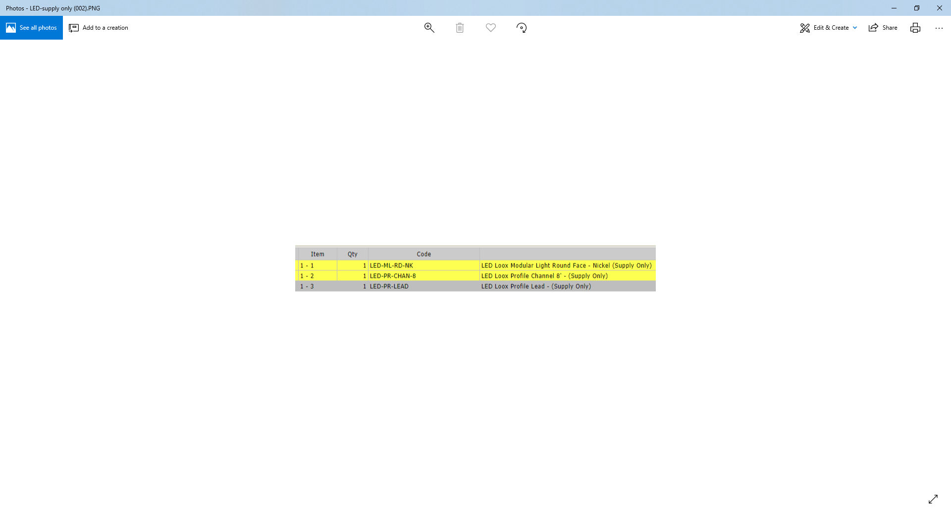
WebQuoin entry and shipping of LOOX LED products
They are shipped loose and installed by the dealer (electrician).
They do not need to be attached to the cabinet in WebQuoin
Use the kits to order the products you need. (kits will have a drop down list in WebQuoin itemizing all items being shipped)They do not need to be attached to the cabinet.
You can also order SUPPLY ONLY individual
parts if needed.
By Scott

Slide 27
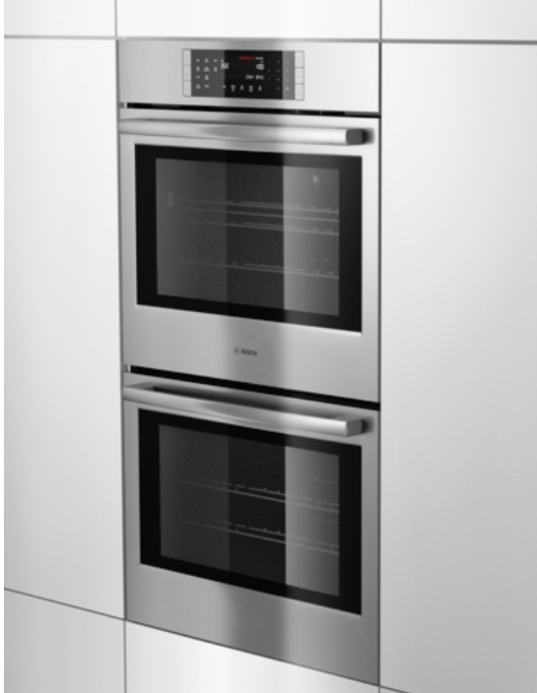
Flush mount
By Scott

Slide 28
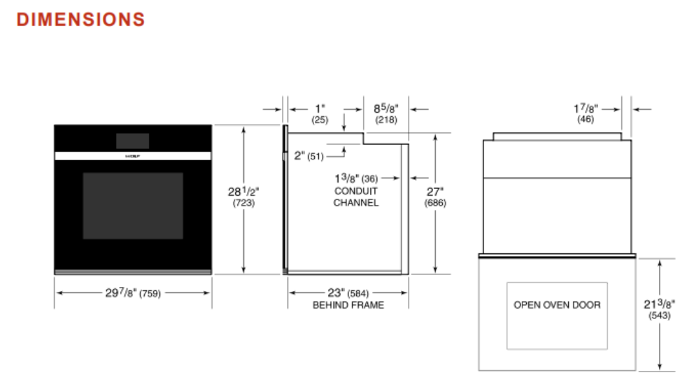
By Scott

Slide 29
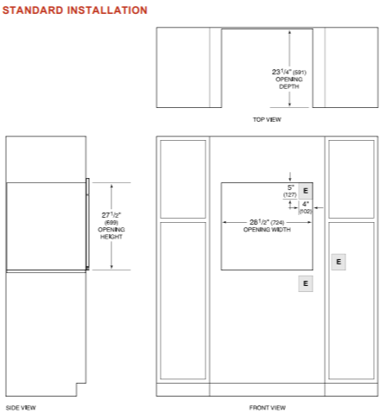
By Scott

Slide 30
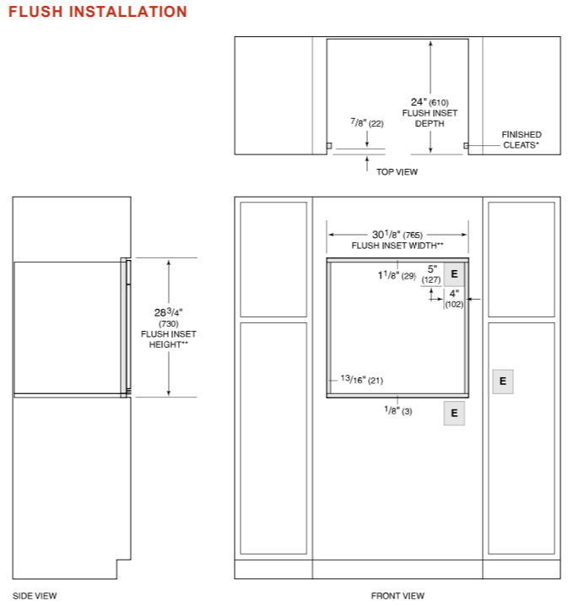
Dealer must supply flush mount appliance specs.
By Scott

Slide 31
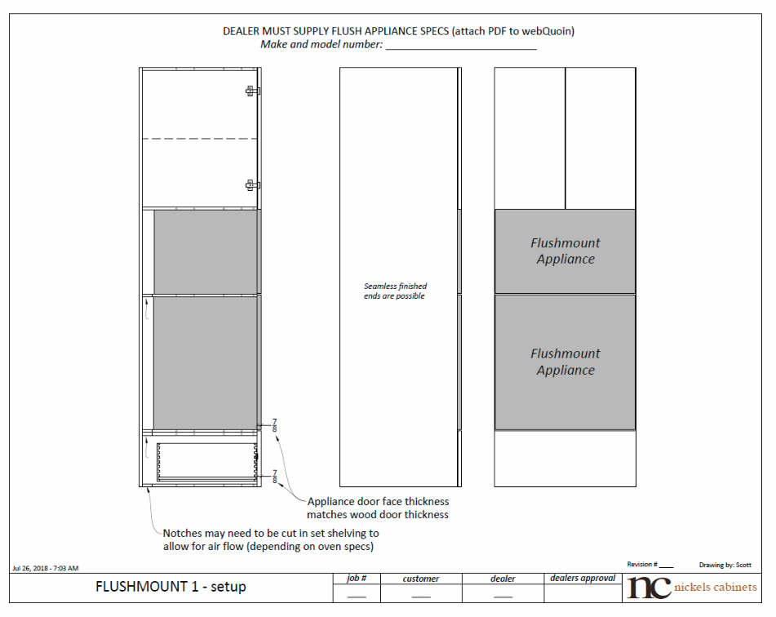
Flush-mount Cabinets (Custom Catalog page 122)
TO1FM_ _ _ _
Defining characteristics:
Door/face thickness that matches the cabinet doors (7/8” thick)
Cabinet width must match appliance width specs
Dealer must supply flush mount appliance specs.
This is the only way will warranty the cabinet.
This will protect appliance from over heating or fire.
By Scott

Slide 32
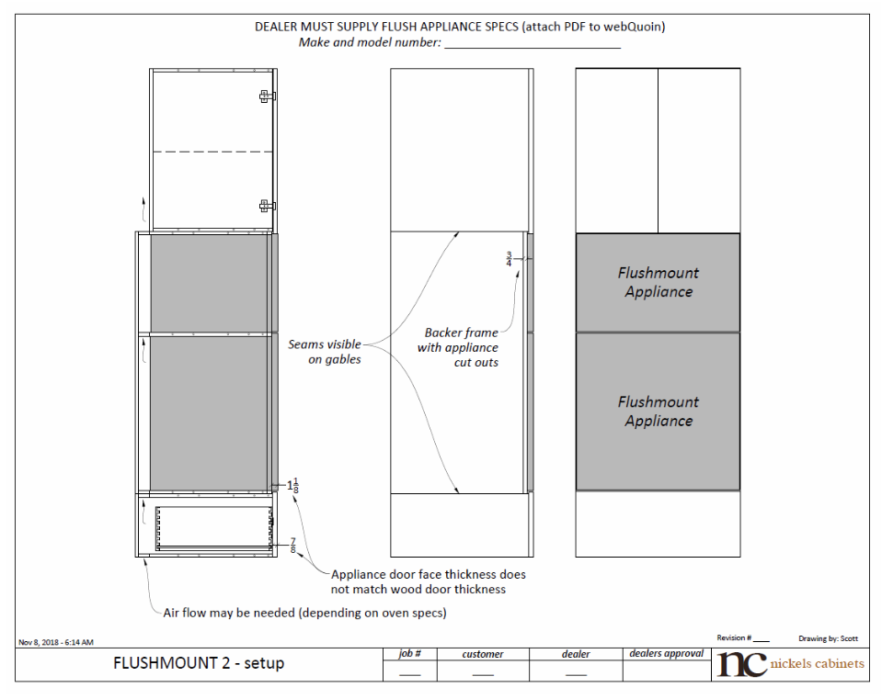
Flush-mount Cabinets (Custom Catalog page 122)
TO2FM_ _ _ _
Defining characteristics:
Has a door/face thickness that is greater than the cabinet doors
Cabinet width must match appliance width specs
Dealer must supply flush mount appliance specs.
This is the only way will warranty the cabinet.
This will protect appliance from over heating or fire.
By Scott

Slide 33
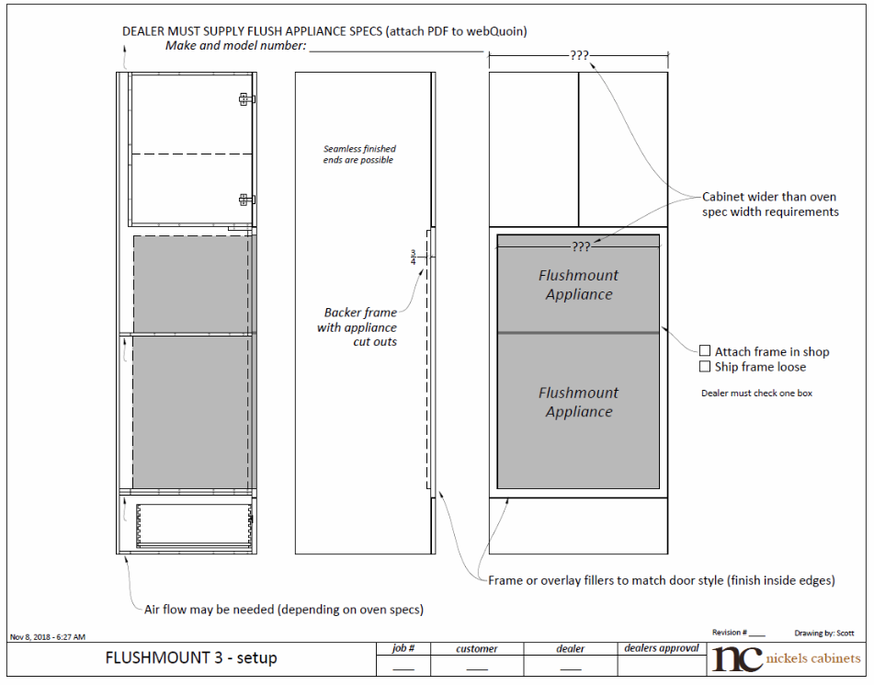
Flush-mount Cabinets (Custom Catalog page 122)
TO3FM_ _ _ _
Defining characteristics:
When the cabinet being order is wider than the appliance spec recommendation.
Dealer must supply flush mount appliance specs.
This is the only way will warranty the cabinet.
This will protect appliance from over heating or fire.
By Scott

Slide 34
HFU Hood Fan Units
By Dieter

Slide 35


HFU
Hood Fan Units
By Dieter

Slide 36
If you have any Questions, please call or e-mail us
Keith J. Grubaugh Director of Sales & Marketing P: +1 604.270.8080 ext. 241
keith@nickelscabinets.com
Tina Krumhardt Order Desk P: +1 604.270.8080 ext. 249
tina@nickelscabinets.com
orderdesk@nickelscabinets.com

